Slide 1
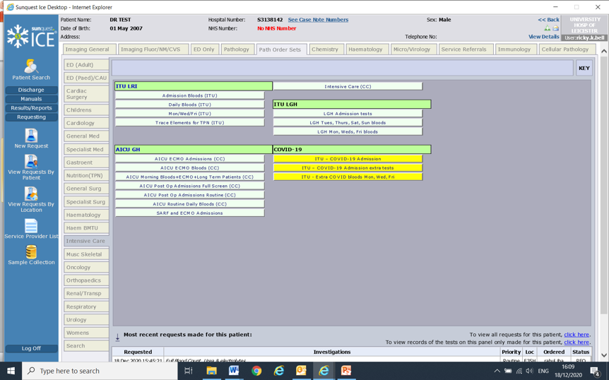
anuja40k@yahoo.co.uk
ICU Audit – Improving communication within the Multidisciplinary Team (MDT)
Dr Anuja Chalishazar, FY2
Dr Ricky Bell, Consultant Renal & ICU
Leicester General Hospital, Leicester, UK
Aim: Improve communication of blood requests and MDT working with the Intensive Care Unit (ICU) nurses.
Background
We looked at how ICU nurses were requesting routine blood tests and if they required any advice from the medical team.
We audited 12 ICU patients who took up a total of 46 bed days.
We looked at which blood tests (except full blood count, urea & electrolytes, clotting and liver function tests) were routinely performed.
We noticed that blood tests for fibrinogen, Gamma GT (GGT), C-Reactive Protein (CRP) and vitamin D were regularly taken and questioned if these were needed.
As an additional point, we noted the cost-effectiveness of each blood test.
Intervention
A checklist of blood test requests was made, for admission and weekdays on ICE to standardize which blood tests are requested as a routine (image below).
This intervention was discussed and agreed with the nursing team.
We sought microbiology advice on ordering daily CRP, as opposed to alternate days.
Results
A survey was distributed to the nurses to ascertain their opinion on the new checklist.
The cost of each blood test was calculated, comparing both cycles.
Cost of each test
Fibrinogen £4.91
CRP £0.63
GGT £3.17
Vitamin D £19.76
 | Cycle 1 | Cycle 2 | Savings/pa
Fibrinogen | £21,258.34 | £2,125.83 | £19,132.51
CRP | £2,432.15 | £636.45 | £1,795.70
GGT | £15,097.32 | £686.24 | £14,411.08
Vitamin D | £2,851.76 | £0 | £2,851.76
 |  |  | £38,191.05
Cycle 1
12 patients
46 bed days
59 fibrinogen (1.2/day)
49 CRP (1.07/day)
61 GGT (1.32/day)
2 Vitamin D (0.04/day)
Table 1 - how much money would be spent on blood tests in each cycle, over a year (pa = per annum)
Conclusions
There is now specific guidance provided for requesting blood tests on ICE.
We have received promising feedback from the nursing team – they find the checklist clear and more time efficient.
Many unnecessary tests were being requested initially.
We have concluded that there is substantial cost-saving for the hospital trust.
Cycle 2
15 patients
50 bed days
6 Fibrinogen (0.12/day)
14 CRP (0.28/day)
3 GGT (0.06/day)
0 Vitamin D (0/day)
Image 1 – ICE form requesting ITU Bloods
The Authors would like to thank the Microbiology and Biochemistry departments at Leicester General Hospital.

